Slide 1
Time for a Break
Group 22
IT314 Software Engineering Project Work
Mid-Sem Assessment

Slide 2
Team Members
Name | Student ID
Shah Aditya Arpit | 201801008
Visaj Nirav Shah | 201801016
Patel Ravi Hitendrabhai | 201801046
Kapadiya Zeal Harshadkumar | 201801085
Vaghela Darshan Rajeshbhai | 201801144
Rajani Harsh Ashokbhai | 201801154
Parmar Meetbhai Manubhai | 201801195
Modi Vyom Rajeshkumar | 201801219
Dangar Mihir Rajeshbhai | 201801220
Makwana Manan Vishalbhai | 201801233

Slide 3
Problem Statement
Vital desktop application for those with high screen time along with a desk job.
To help such customers break the monotony and remind them to take a break at regular intervals, Time for a Break is the go-to app.
This user-friendly app provides all the necessary functionalities for those planning to follow a healthy regime comprehensively.

Slide 4
Functional Requirements
Change break Duration -If the user feels that the break duration is more than he/she requires then he can change it.
Postpone-The user can postpone the break if he wishes to continue with the work he is doing.
Cancel-This feature enables the user to cancel the break.
Strict mode -It prevents the user from skipping either mini breaks or long breaks and is designed to disciplined the user.
Don’t disturb mode:App monitor the don’t disturb mode.So breaks are paused when DND mode is on.

Slide 5
Report generation-At some specified time of a day, a daily report would be displayed to the user containing all the information about user activities during different time breaks.
Reset break-this feature will enable the user to reset the breaks meaning all the previous settings will be set in a way as if the app has started again.
Notification Preferences-the user will be able to change the notification settings like don’t show the minibreak notification beforehand.Similarly for a long break.
Audio preference:A audio is played whenever the break period ends to remind the user to get back to work .

Slide 6
Non-Functional Requirements
Target Operating system:Windows 10
The application’s clock should be properly synchronized with the system’s clock.
If the user has selected strict mode then he/she has to take a break.
Storage requirements:Local storage will be used by the application for its functionalities.
Performance Constraints:Response time against some specific sort of user activity.
The app should be able to work without any active internet connection i.e it will be native desktop application.
There should not be any disturbance from the app while in ‘do not disturb’ mode.

Slide 7
Requirement Elicitation Techniques Used
Google Forms
Interviews
Informal Discussions
General Reading

Slide 8
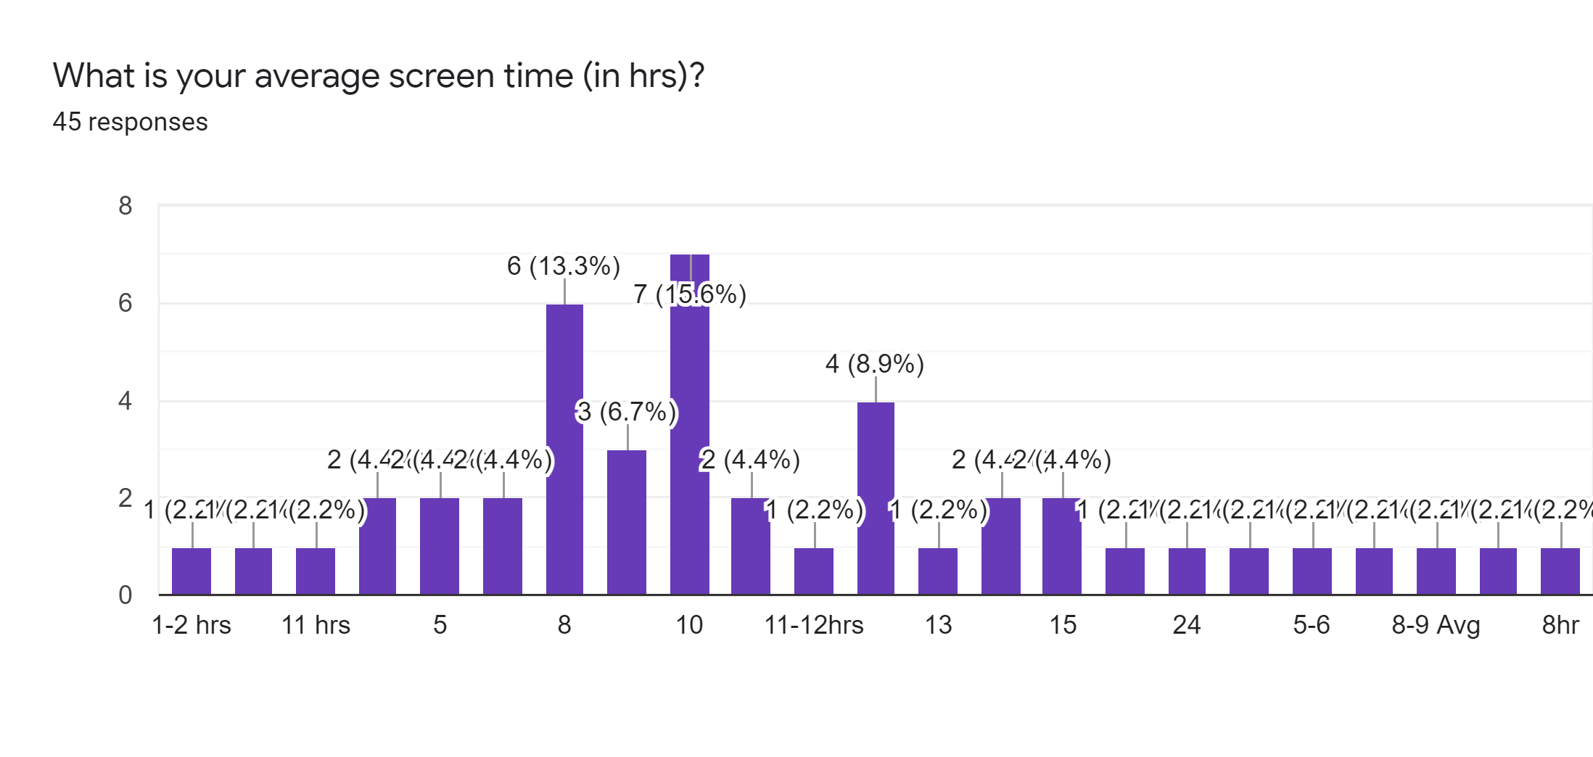

Slide 9
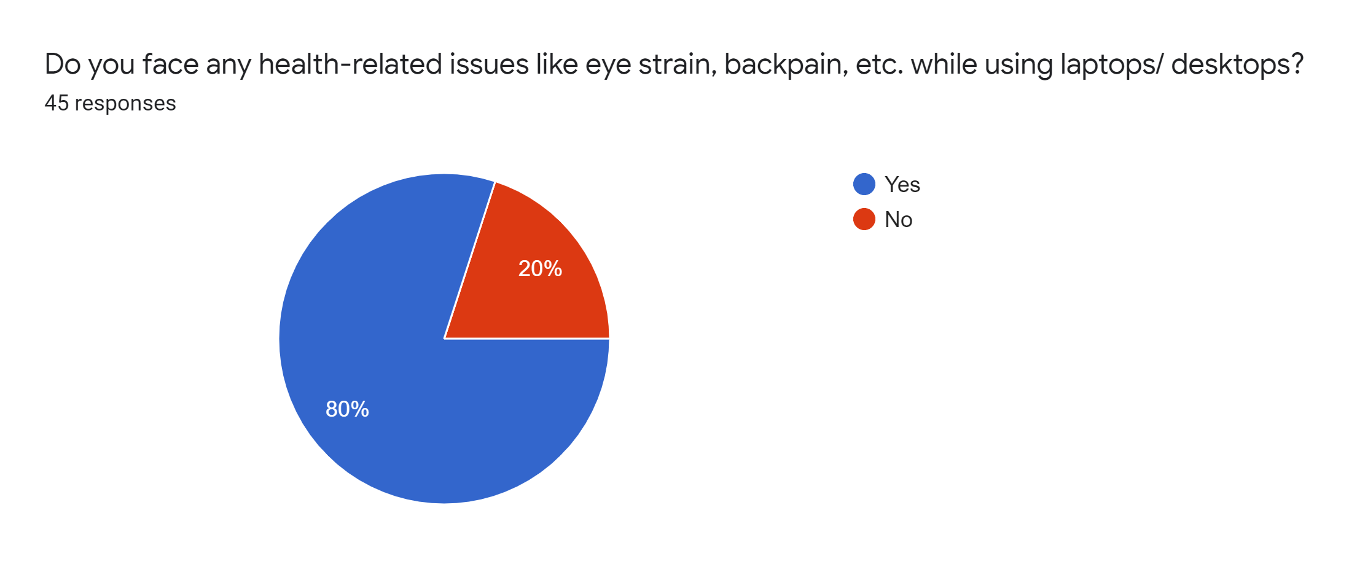


Slide 10
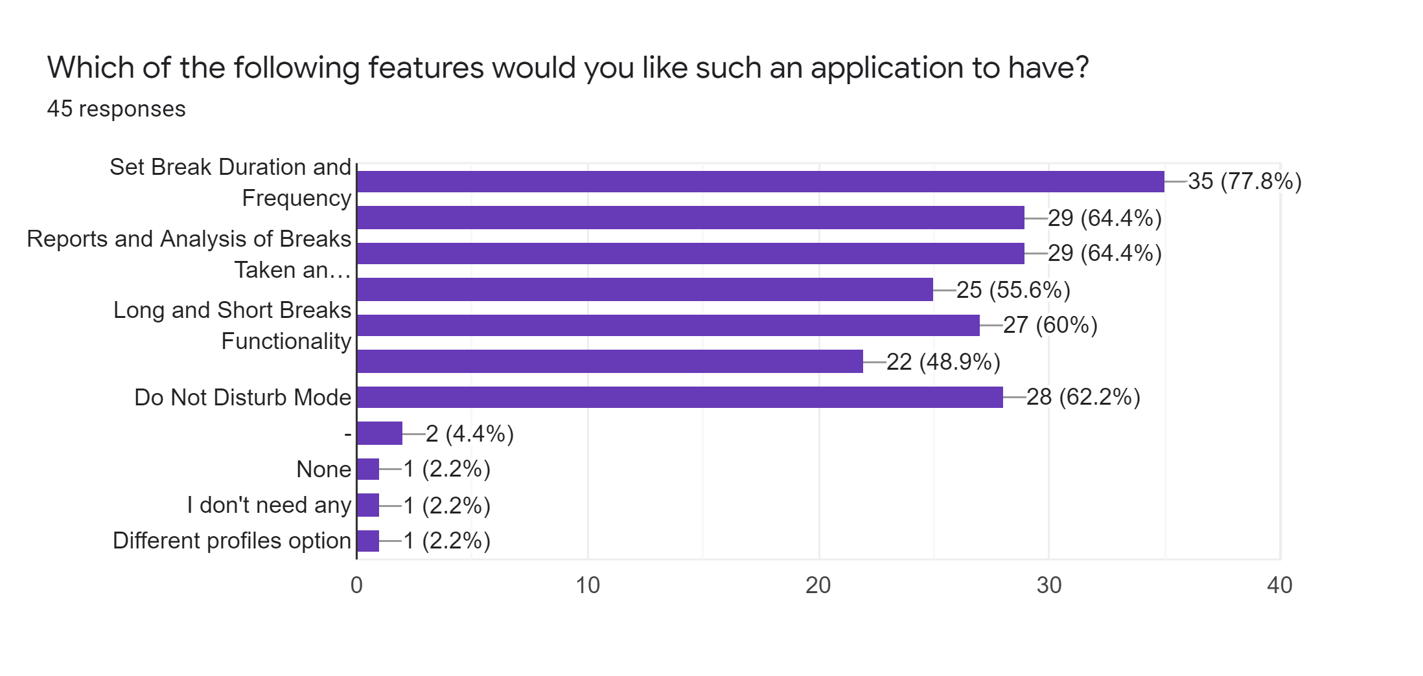

Slide 11
Iterative Waterfall Model
Iterative waterfall model fit for our project because the problem statement and customer requirements are fairly simple and clear.
Waterfall model is the best match but,the classical waterfall model would not comply with our project as we need some sort of feedback at every stage.
Thus iterative waterfall model is very much appropriate.

Slide 12
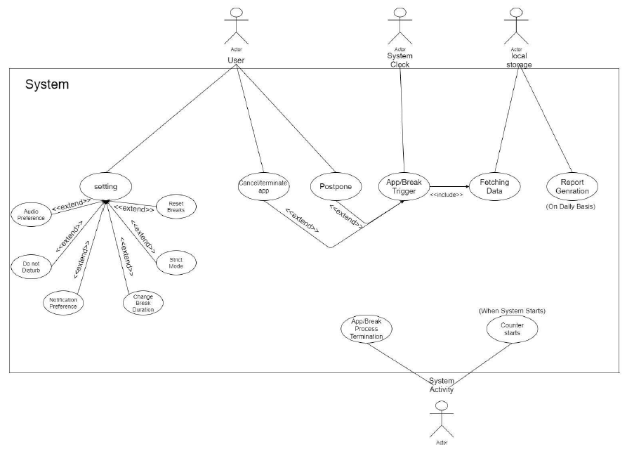
Use Case Diagram

Slide 13
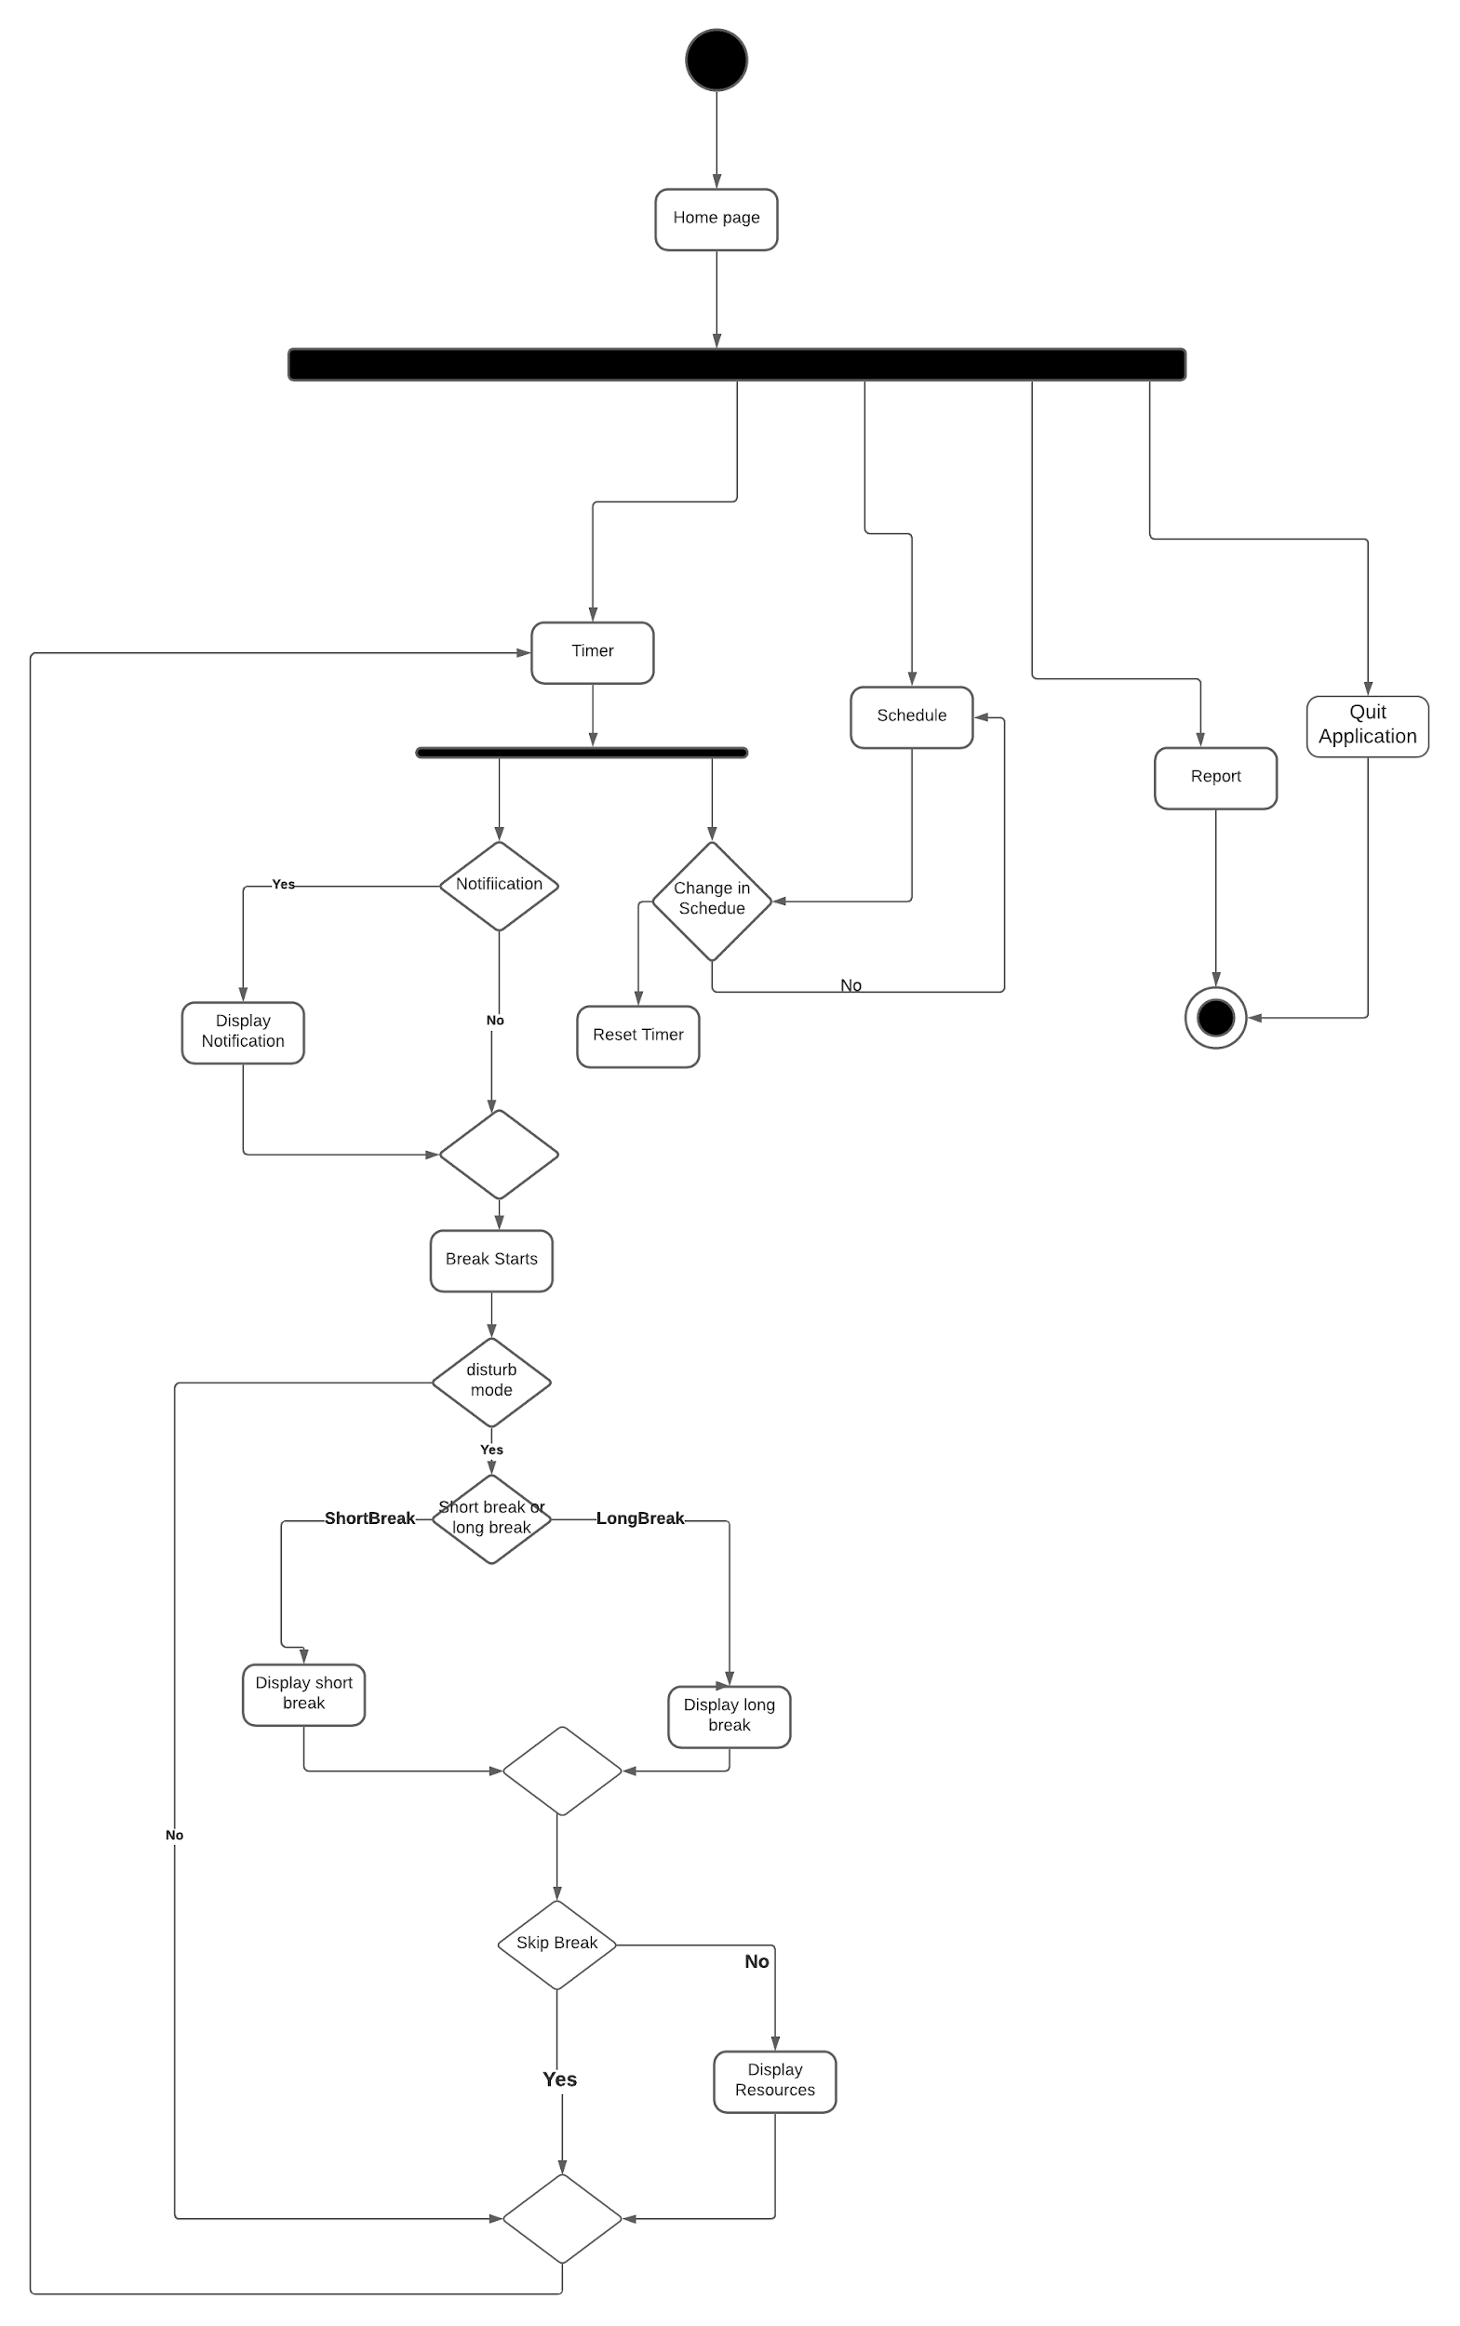
Activity Diagram
In case the image is not clear, visit:
http://tiny.cc/activitydiagram

Slide 14
The Way Ahead...
Finalize the remaining functionalities
Work on Feedback collected
System Design and Architecture
Testing
Auxiliary Features

Slide 15
Thank You

